Slide 1

IMAD5111 PRACTICUM
Kamogelo Mayisela
ST10443396
Group 3
HAW1

Slide 2
Problem Statement and Objectives
weather station.
A team of developers are working on creating a weather app, and they are working in

Slide 3
-State the objectives of your app
Solving a Problem: Many apps are created to address specific issues or needs that users face. Whether it's simplifying a task, providing entertainment, or facilitating communication, solving a problem is often a primary objective.Generating Revenue: Apps can be created as a source of income through various monetization strategies such as in-app purchases, subscriptions, advertising, or selling the app itself.Building Brand Presence: For businesses, creating an app can be a way to strengthen their brand presence, engage with customers, and enhance loyalty. It can serve as a direct channel for communication and interaction with users.Expanding Reach: Apps can help businesses expand their reach to new markets or demographics, especially if they provide services or content that appeal to a global audience.Improving Efficiency: In the workplace, apps can be developed to streamline processes, enhance productivity, and improve communication among employees.Collecting Data and Analytics: Apps can serve as a valuable source of data and insights into user behavior, preferences, and trends, which can inform business decisions and strategy.Offering a Competitive Edge: In crowded markets, having a well-designed and functional app can differentiate a business from its competitors and attract more customers.

Slide 4
-Briefly describe the app functionality and feature
Current Weather Conditions: Display real-time information about the current weather, including temperature, humidity, wind speed and direction, visibility, and atmospheric pressure.Weather Forecasts: Provide forecasts for upcoming hours, days, or weeks, indicating expected changes in weather conditions such as temperature fluctuations, precipitation, and wind patterns.Location-Based Services: Use GPS or user-input location data to deliver weather information specific to the user's current location or any location of interest.

Slide 5
-Mention the screen
Splash Screen
This screen is the first screen of the application. It consist of the name and surname of the student, the student number, the t logo for the application.
It also consist an option to navigate to the main screen or exit the application.
Main Screen

Slide 6
-Declarations & Initialization
Some of the stuff I had to start over
I Started over a 5 times and I still did not figure out the problem so what I now is all I had to f

Slide 7
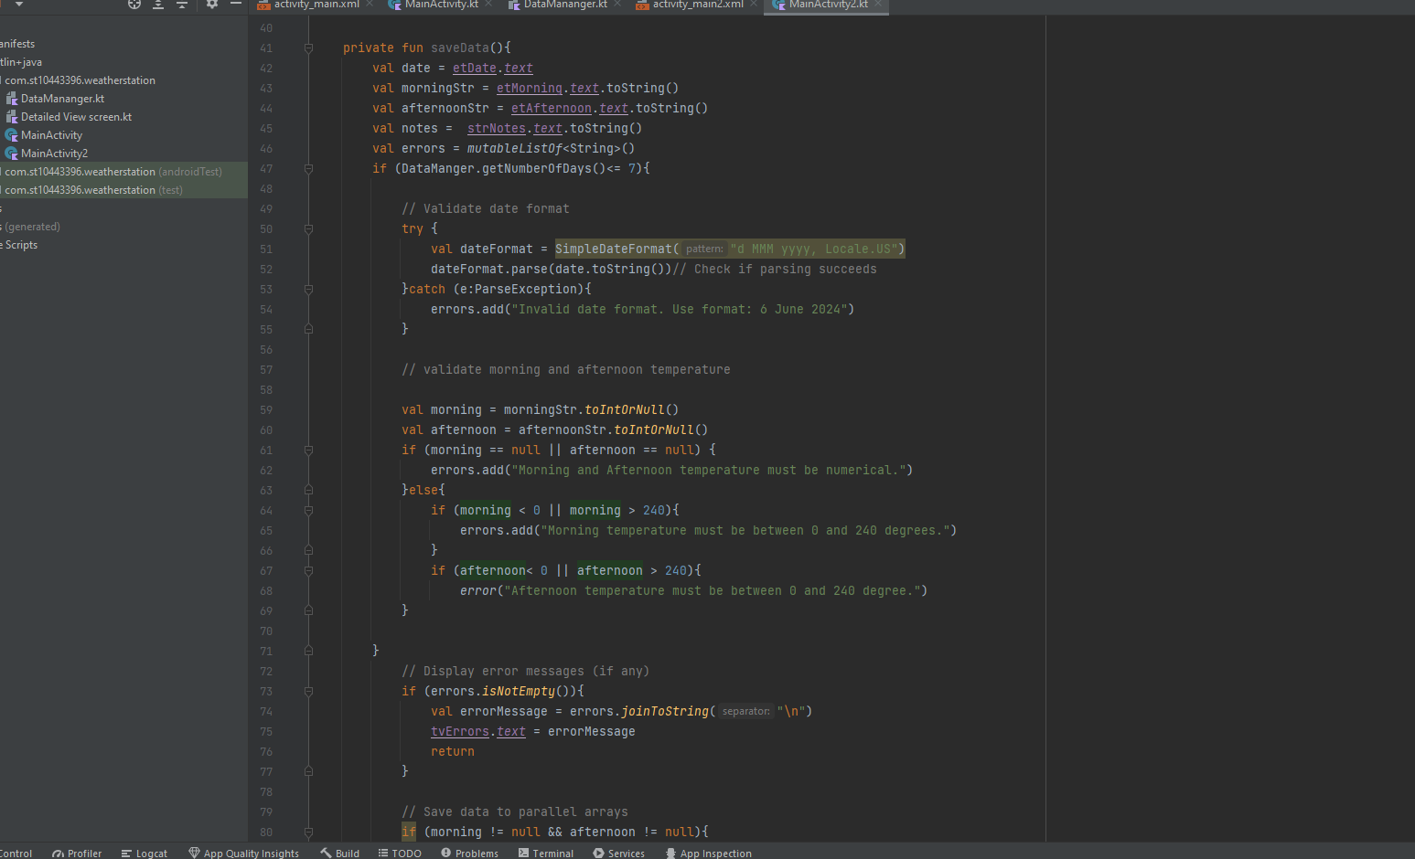

Slide 8
Link of the repo
https://github.com/st1044339/weather-station

Slide 9
conlcusion
This was very hard for me and

